Slide 1
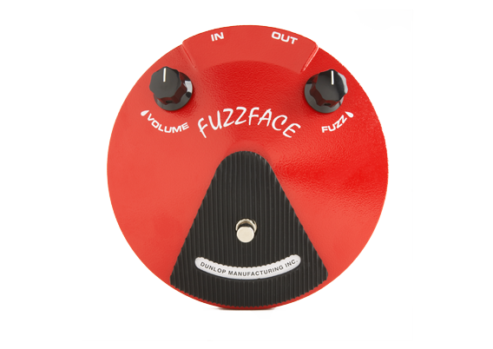
Overdrive, Distortion and Fuzz

Slide 2
Terminology
Overdrive, distortion and fuzz used primarily by guitar players
Sometimes used interchangeably, but sometimes a distinction
Overdrive
Becomes nonlinear when driven with signal above operating range
Operation linear for softer signals, nonlinear for louder signals
Characteristic sound comes from nonlinear region
Warm, smooth sound in nonlinear region
Distortion
Operates in nonlinear region
Signal reaches point of clipping where output fixed to maximum level
Used for metal and grunge sounds
Fuzz
Completely nonlinear effect
Harder, harsher sound than distortion
“Buzzy” sound with long sustain

Slide 3
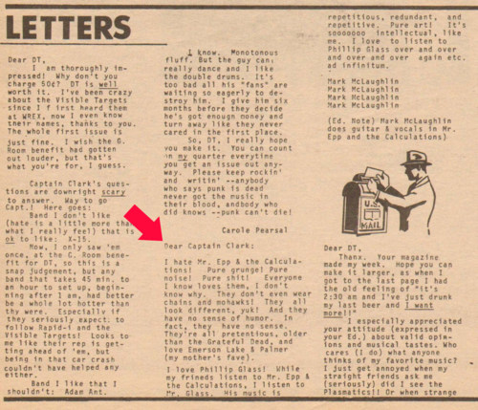
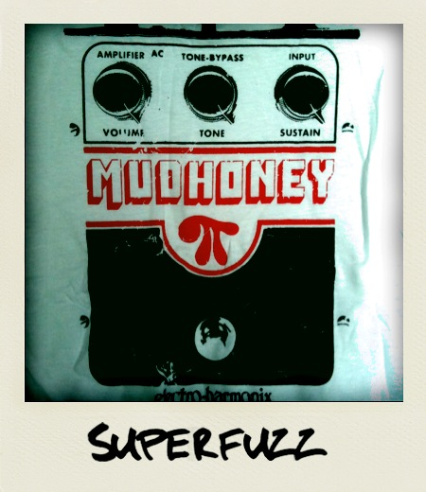
Grunge

Slide 4
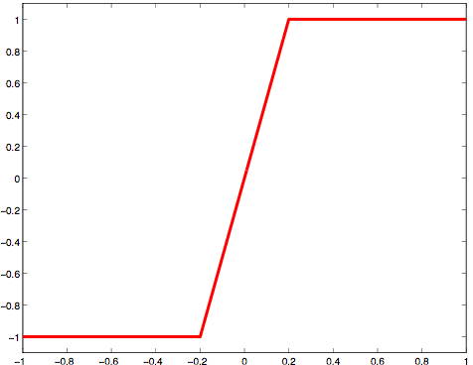
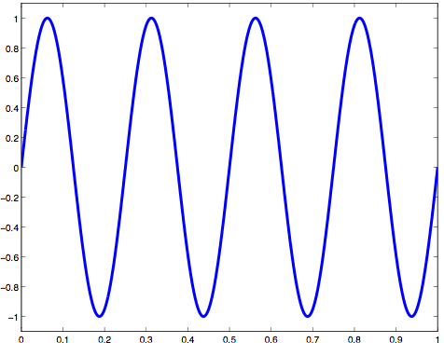
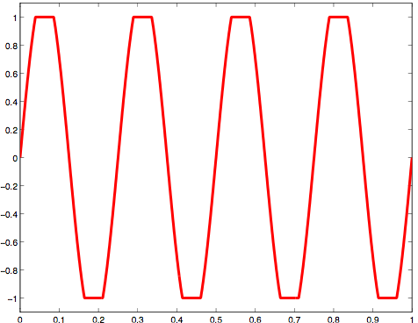
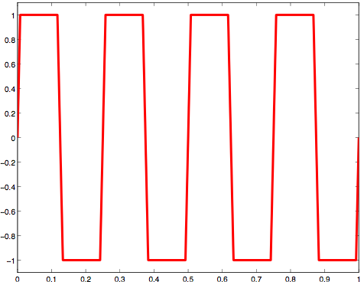

Clipping
Simplest form of distortion: clip the waveform
Apply an input gain and hold the output to a fixed max value
Known as hard clipping (abrupt transition)
Aggressive, bright sound
Example (G = 5)
Transfer function (G = 5)
Example (G = 1.2)
Input
Output
Output
Input
Time
Sound examples: original, G = 10, G = 100
Music example: Beatles Revolution

Slide 5
Soft clipping (overdrive)
Most analogue systems have smooth transition from linear to nonlinear
Rounded tops of waveforms known as soft clipping
Notice: G = 2
Characteristic input/output curve for a quadratic distortion.

Slide 6
Effect of soft clipping on a decaying sinusoid

Slide 7
Soft clipping of a sine wave with four different input gains.

Slide 8
Comparison of hard and soft clipping.

Slide 9
Spectrum after distortion has been applied for sinusoidal input
Varying distortion level, soft clipping soft and hard clipping

Slide 10
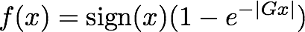
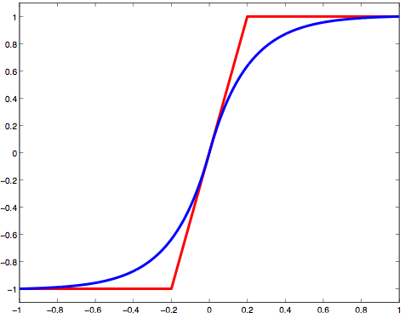
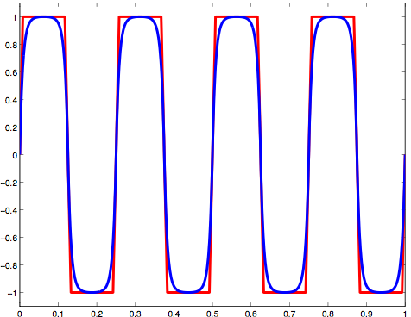
Soft clipping
Another implementation of soft clipping
Exponential function grows gradually more nonlinear as input gain increases
Asymptotically approaches clipping point
Sound examples: hard, soft (G = 10)
Transfer function (G = 5)
Hard vs. Soft clipping (sine input)
Output
Output
Input
Time

Slide 11
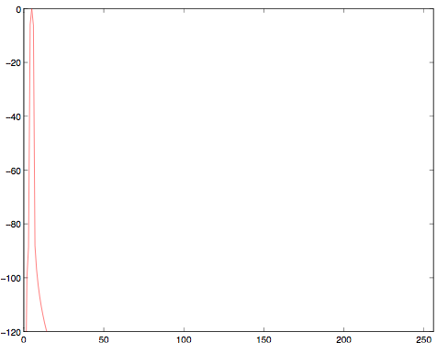
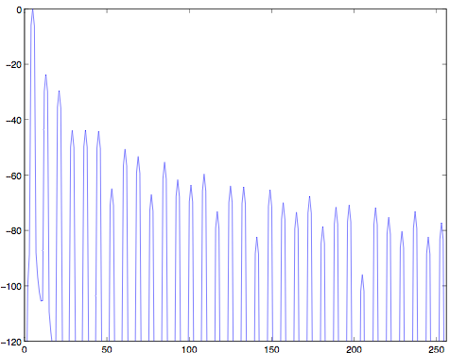
Distortion in the frequency domain
Distortion is a nonlinear effect (why?)
Nonlinearity introduces new frequency components that weren’t present in original signal
Fourier Transform: Sine input
Fourier Transform: Hard clipping (G = 5)
Magnitude (dB)
Magnitude (dB)
Bin #
Bin #

Slide 12
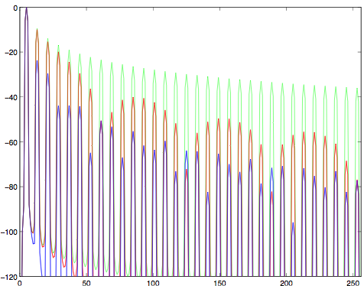
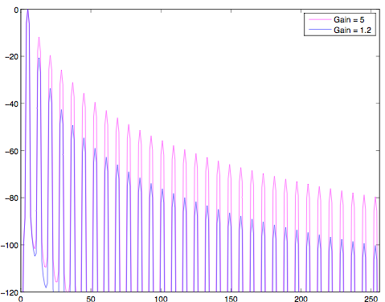
Distortion in the frequency domain
Spectrum depends on amount and type of distortion
What’s special about the location of the new components?
Harmonics (multiples) of the original, and specifically...
Odd harmonics
Hard clipping: G = 1.2, 5, 1000
Soft clipping: G = 1.2, 5
Magnitude (dB)
Magnitude (dB)
Bin #
Bin #

Slide 13
Waveshapers and harmonics
Waveshaper: any function mapping current input sample to current output sample
No memory dependence
Three questions
Do waveshapers produce only harmonic distortion for sinusoidal input?
Do waveshapers produce inharmonic distortion for nonsinusoidal input?
What distortion results when the waveshaper is an odd or an even function?

Slide 14
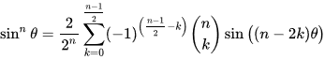
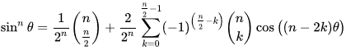
1. harmonic distortion – first attempt
Do waveshapers produce only harmonic distortion for sinusoidal input?
Any function can be approximated as a polynomial series expansion
Assume the input is a sinusoid
So
But this gets really messy, really quick
n is odd:
n is even:

Slide 15
1. harmonic distortion – second attempt
Do waveshapers produce only harmonic distortion for sinusoidal input?
Any function can be approximated as a polynomial series expansion
Assume the input is a complex sinusoid
So
→ only harmonics (multiples) of the input frequency

Slide 16
2. inharmonic distortion
Do waveshapers produce inharmonic distortion for nonsinusoidal input?
Any function can be approximated as a polynomial series expansion
Assume the input is a complex sinusoid
So
Yes! Sum of input frequencies, not just multiples

Slide 17
3. Symmetry and harmonics
What distortion results when the waveshaper is an odd or even function?
Odd function:
Examples: Most op-amp, transistor, digital systems
Even function:
Examples
Important property
Sum of odd functions is odd
Sum of even functions is even
Sum of odd and even functions is neither (unless one of them is 0)

Slide 18
3. Symmetry and harmonics
What distortion results when input is odd or even function?
Sum of odd functions is odd
Sum of even functions is even
Sum of odd and even functions is neither
So
So if f is odd
If f is even
For complex sinusoid

Slide 19
Waveshapers and harmonics
Waveshaper: any function mapping current input sample to current output sample
No memory dependence
Answers to three questions
Waveshapers produce only harmonic distortion for sinusoidal input
Waveshapers produce inharmonic distortion for nonsinusoidal input
Even functions give even harmonics, odd functions give odd harmonics, for sinusoidal input

Slide 20
Even and odd functions
Odd: f(-t)=-f(t)
Even: f(-t)=f(t)
Odd function times even function is an odd function
h(-t)= f(-t) g(-t) = - f(t) g(t)=-h(t)
Integral of odd function over symmetric interval is 0
Integral of even function over symmetric interval

Slide 21
Recall the Fourier Series
Cos is even, sine is odd
Even f(-t)=f(t)
Odd f(-t)=-f(t)

Slide 22
And finally…
Cos is even, sine is odd
Even f(-x)=f(x)
For odd n, is odd around T/4
→a_{n}=0, only even harmonics
Odd f(-x)=-f(x)
For even n, is even around T/4
→ b_{n}=0, only odd harmonics

Slide 23
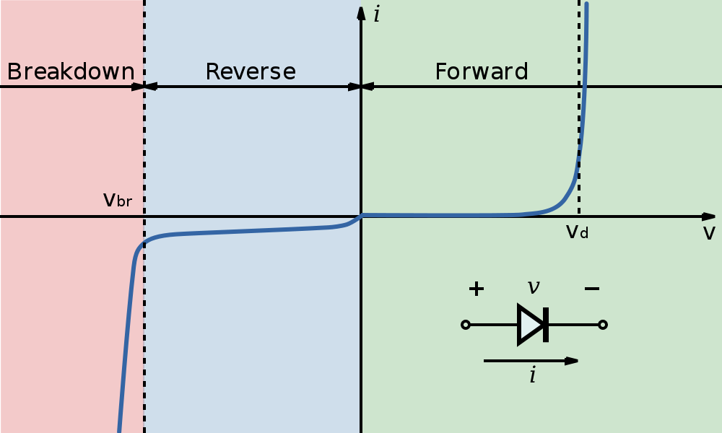
Analogue and digital
Why soft clipping is a good simulation
Most fuzz boxes (overdrive units, distortion pedals) use diodes to clip the signal
Could theoretically simulate the characteristics of the particular diode

Slide 24
Tube distortion
Many guitarists still prefer vacuum tube amps
Tube distortion has warmer, “bluesier” sound than transistor distortion (hard or soft)
original information about what input wave used to be not lost, just compressed
Form of soft clipping, with two major differences:
Sound examples: clean and tube-like distortion
Simulating a real tube amplifier is hard!
Most emulations are not perfect replicas
1. More rounded edges
2. Asymmetrical

Slide 25
Spectrum of a single sine wave before and after asymmetric distortion has been applied

Slide 26
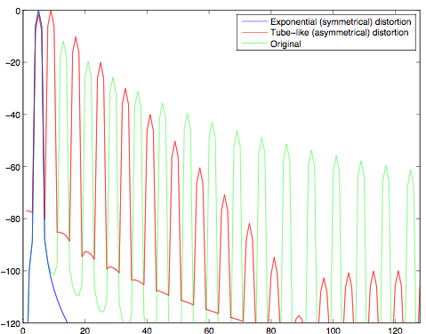
Tube distortion
Tube distortion produces even harmonics
Often a combination of even and odd

Slide 27
Rectification
Another form of asymmetrical distortion
Full-wave rectification flips the negative half of the signal
Equivalent to absolute value function
Half-wave rectification passes only the positive half
Both forms produce strong octave harmonic (2x frequency)
Full-wave rectification eliminates the fundamental frequency
Used in many fuzz pedals:
Tycho Brahe Octavia, UniVox SuperFuzz,
Foxx Fuzz-Wah, and Foxx Tone Machine

Slide 28
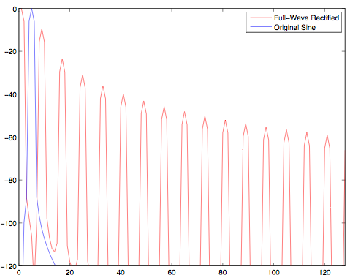
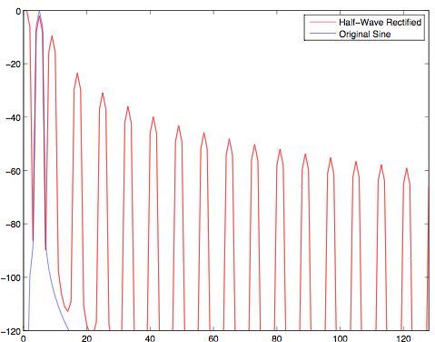
Rectification
Spectrum shows even harmonics
Notice component at DC (f = 0)
Half-wave = full-wave + original (mathematical identity)
Sound examples: clean, half-wave, full-wave
Spectrum: full wave rectification
Spectrum: half wave rectification
Magnitude (dB)
Bin #
Bin #

Slide 29
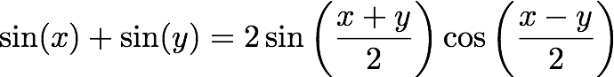
Intermodulation distortion
The bane of fuzzbox technology
Trig. identity:
Sum and difference frequencies are products of intermodulation between inputs
When we apply nonlinear distortion, intermodulation products will show up in the spectrum
If two tones are harmonically-related
Intermodulation products will be harmonically-related as well
If two tones are not harmonically-related
Intermodulation produces will be harsh and dissonant
Exact guitar tuning is especially important when using distortion!
Goal: maximise harmonic distortion, minimise intermodulation distortion

Slide 30
Spectrum of two sinusoids before and after distortion applied

Slide 31
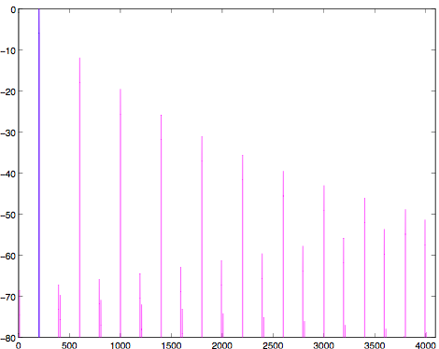
Aliasing
Products of distortion are not band-limited
Harmonics that exceed Nyquist frequency are folded back into spectrum
Exponential (soft clipping) distortion: aliasing
8192-point FFT
(4096 = fs/2)
Magnitude (dB)
Bin #

Slide 32
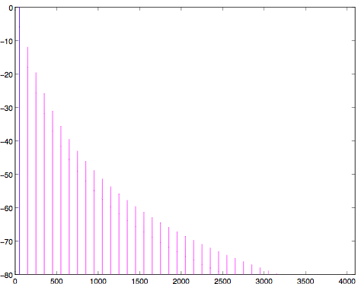
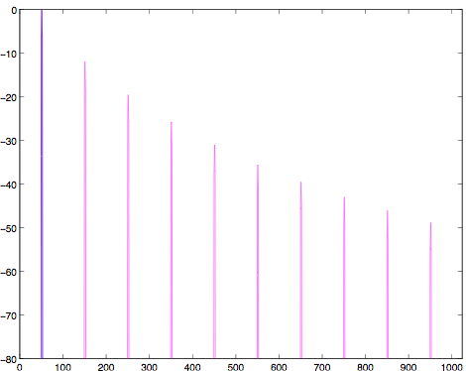
Aliasing
One possible solution
Operate at higher sampling rate, filter & downsample
Same distortion at 4x sampling rate
Original frequency range (now 0-fs/8)
Magnitude (dB)
Bin #
Bin #

Slide 33
Output spectrum with aliasing due to distortion, and output spectrum after oversampling, lowpass filtering and downsampling.

Slide 34
Memory and analogue simulation
Nonlinearities discussed earlier are memoryless
Current output depends only on current input
Real fuzz boxes don’t work this way
The nonlinearity depends on diodes and RC filter
RC (lowpass) filter in particular has a memory effect
Simple approach: lowpass filter, then nonlinearity
Nonlinearity can be calculated by lookup table
But the two components aren’t truly independent!
Current through diode affects the operation of the RC filter.
D. Yeh, J. Abel , J. Smith. Simulation of the diode limiter in guitar distortion circuits by numerical solution of ordinary differential equations. Proc. Digital Audio Effects (DAFX) 2007.

Slide 35
Analogue modelling references
D. Yeh, J. Abel and J. O. Smith. Simulation of the diode limiter in guitar distortion circuits by numerical solution of ordinary differential equations. In Proc. Digital Audio Effects (DAFX) 2007.
D. Yeh, J. Abel, A. Vladimirescu and J. O. Smith. Numerical methods for simulation of guitar distortion circuits. Computer Music Journal 32(2), pp. 23-42, 2008.
J. Pakarinen and D. Yeh. A review of digital techniques for modeling vacuum-tube guitar amplifiers. Computer Music Journal 33(2), pp. 85-100, 2009.
J. Pakarinen and M. Karjalainen. Enhanced wave digital triode model for real-time tube amplifier emulation. IEEE Transactions on Audio, Speech, and Language Processing 18(4), pp. 738-746, 2010.

Slide 36
Distortion code
int numSamples; // Indicates how many audio samples to process
float *channelData; // Array of audio samples, length numSamples
float inputGain; // Input gain (linear scale), before distortion
float inputGainDecibels_; // Gain in decibels, from the user control
int distortionType_; // Index containing the type of distortion
// Calculate input gain once to save calculations
inputGain = powf(10, inputGainDecibels_ / 20);
for (int i = 0; i < numSamples; ++i) {
const float in = channelData[i] * inputGain;
float out;
…[SEE NEXT SLIDE]
// Put output back in buffer
channelData[i] = out;
}

Slide 37
Distortion code- Apply distortion based on type
if (distortionType_ == kTypeHardClipping) {
float threshold = 1;
if(in > threshold) out = threshold;
else if(in < -threshold) out = -threshold;
else out = in;
}
else if (distortionType_ == kTypeSoftClipping) {
float threshold1 = 1/3, threshold2 = 2/3;
if(in > threshold2) out = 1;
else if(in > threshold1) out = (3-(2-3*in) * (2-3*in))/3;
else if(in < -threshold2) out = -1;
else if(in < -threshold1) out = -(3-(2+3*in) * (2+3*in))/3;
else out = 2* in;
}
else if (distortionType_ == kTypeSoftClippingExponential) {
if(in > 0) out = 1 - expf(-in);
else out = -1 + expf(in);
}
else if (distortionType_ == kTypeHalfWaveRectifier) {
if(in > 0) out = in;
else out = 0;
}
else if (distortionType_ == kTypeFullWaveRectifier) out = fabsf(in);

